Slide 1

FEUDAL
Federated User Credential Deployment Portal
Uros Stevanovic
SA1
Karlsruhe Institute of Technology
AARC AHM, Milan, Italy
19-22.11.2018

Slide 2

In the beginning….

Slide 3



“Science”

Slide 4


“Cloud”

Slide 5



Remote resources

Slide 6
Remote access
“AARC BPA”

Slide 7
Remote access
“AARC BPA”
#MAAGA

Slide 8





Remote access

Slide 9
Remote access
Accounts
(Credentials)

Slide 10
“User deployment”
User “creation” → Account provisioning
  Creating/assigning a user account on the Service side
  E.g. name, group, home folder
Deploying a credential for a user
  SSH
  Password
  Tokens

Slide 11
“User deployment”
User “creation” → Account provisioning
  Creating/assigning a user account on the Service side
  E.g. name, group, home folder
Deploying a credential for a user
  SSH
  Password
  Tokens
TTS service
(existing solutions)

Slide 12
“User deployment”
User “creation” → Account provisioning
  Creating/assigning a user account on the Service side
  E.g. name, group, home folder
Deploying a credential for a user
  SSH
  Password
  Tokens

Slide 13
“User deployment”
User “creation” → Account provisioning
  Creating/assigning a user account on the Service side
  E.g. name, group, home folder
Deploying a credential for a user
  SSH
  Password
  Tokens
Federated User Credential Deployment Portal
FEUDAL

Slide 14
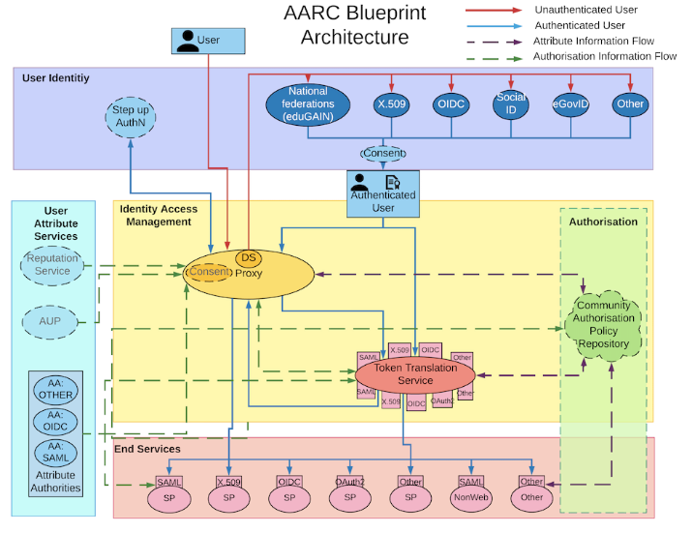
AARC BPA

Slide 15
AARC BPA
FEUDAL

Slide 16
FEUDAL requirements
Web Portal
Deployment
  Federated user authentication
  Credentials: SSH public keys
  Fault tolerant
  Fast response time
Services
  Distributed
  Services can be hosted at multiple sites
  Sites can host multiple services
At the sites:
  Interface with all possible User Management Systems (within reason)
  Customisable by the local Administrator
  Easy integration
  Management of no incoming connections
Secure

Slide 17
FEUDAL architecture
Distributed:
  FEUDAL clients
  Every site hosts one or more clients
  The clients execute the deployments
Central elements:
Web portal
  User interface
FEUDAL backend + database
  Sends messages to the clients
  Stores user information and credentials

Slide 18
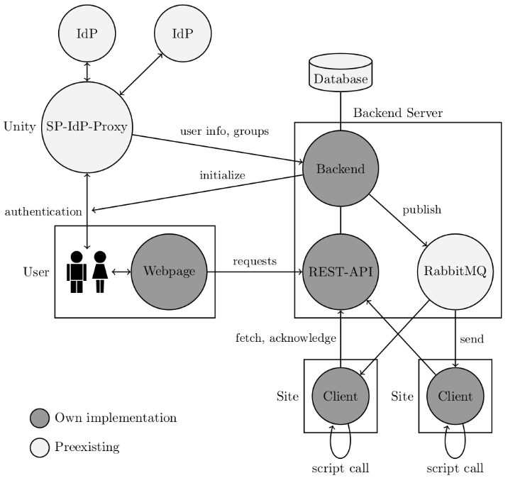
Architecture

Slide 19
Architecture
Interface to SP-IdP-Proxy: OpenID Connect
Backend: Django/Python
  Inbuilt administration frontend
  Simplifies usage of Database
Django REST Framework
Clients: Go (others supported)
  Static linking
Webpage: Angular/Typescript

Slide 20
Messaging
JSON
Backend → Client:
  identifier
  action ∈ { “deploy”, “remove” }
  service
  SSH public key
  user info (from OpenID Connect)
  group memberships (from Unity)
Backend ← Client: Acknowledgement
  identifier

Slide 21
Messaging
Publish Subscribe
Quick transmission (close to network latency)
Only outgoing connections at the clients
Dedicated message broker: RabbitMQ
  Delegated authentication of clients
  Inbuilt message routing

Slide 22
DEMO

Slide 23
Summary
FEUDAL provides:
Account provisioning
Deploying credentials
Key features:
Realtime deployment: Instant feedback for users
Asynchronous deployment: Retransmission of information (if sites are offline)
“Discovery” deployments: "new" sites/resources (in a “VO”) automatically receive info
Full sites control integration: system admins provides “mechanisms/call-outs” for user management
FEUDAL transmits “unmodified” user information

Slide 24
uros.stevanovic@kit.edu

Slide 25
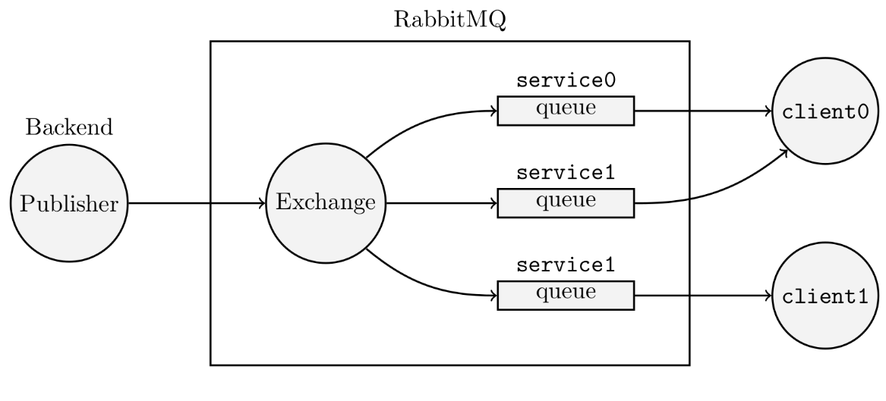
Messaging
Clients receive only messages for the services of their site.

Slide 26
Messaging
Clients manually fetch messages
On startup
  Missed deployments
Per interval (e.g. 30 minutes)
  Result: Unacknowledged deployments are retried

