Slide 1
Update on FIM4R
Authentication and Authorisation for Research and Collaboration
David Kelsey
AARC2 Task Leader NA3.4 Community Engagament
STFC-RAL
AARC2 All Hands Meeting, Nikhef, Amsterdam
23 Nov 2017

Slide 2
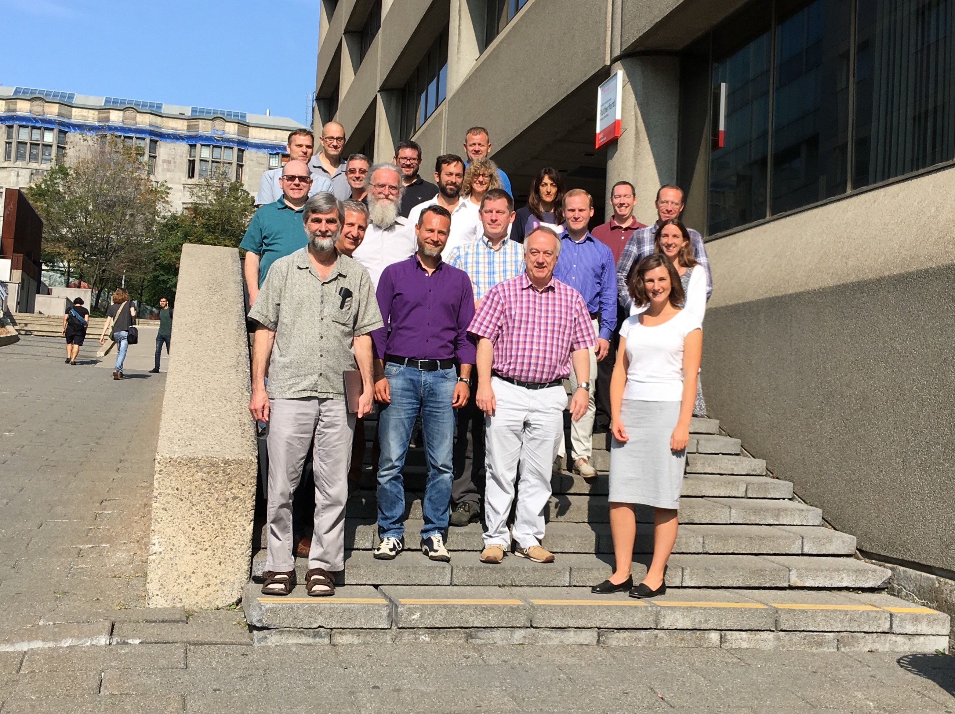
11th FIM4R Workshop - Montreal
We now have a web site!
  https://fim4r.org/
18-19 Sep 2017
Hosted by Department of Physics, McGill University
28 people attended
Co-located with Research Data Alliance (RDA) - 10th meeting
  Chaired by DPK and Hannah Short
https://indico.cern.ch/event/647693/
Main aim was to progress FIM4Rv2 paper
First time in North America

Slide 3
Agenda of 11th FIM4R
Reports from new Research Communities& updates from existing FIM4R member communities
  Virtual Atomic and Molecular Data
  LIGO (Gravitational Waves)
  DARIAH (Humanities)
  Umbrella & CALIPSOplus (Photon & Neutron)
  ELIXIR, CORBEL & GA4GH (Life Sciences)
  WLCG (Particle Physics)
  US NIH (Infectious Diseases)
Talks from local identity federations and e-Infrastructures (Canada, USA)
Updates from various projects & e-Infrastructures
  AARC (EU project on AAI for research collaboration), Canadian projects (CANARIE), US Projects (CI-Logon), UK Project Moonshot, HNSciCloud Project, EGI Check-in

Slide 4
Community Survey
The FIM4R version 2 - Community Survey
  Original plan was to perform this *before* version 2 paper
  To reach out to all those who are not yet members of FIM4R
  Which communities to target?
    The not-yet-involved ESFRIs
    Communities connected to US Texas TTAC
    New domains, such as Chemistry, Botany, Radio Astronomy, ..
    Research communities involved in RDA
  How should the survey be done?: just send it out, do interviews, have a short summary first?
  In the end we decided to delay the questionnaire until after version 2
    Expecting a version 2.1, or even version 3?

Slide 5
Requirements gathering (Day 1)
Progress and plans for FIM4R version 2 paper
Requirements Gathering
  Easier Service Provider onboarding
  Better testing ability
  Better IdP discovery
  Support for non-legal entities
  Use of SP-IdP proxies
  …

Slide 6
FIM4R paper version 2 (Day 2)
Decisions made re contents of the paper
  Will included a table describing the communities
  Success stories on what we have achieved in last 5 years
  Ongoing requirements collection – also at Internet2 TechX meeting
  A text on new recommendations to
    Research infrastructures (& e-Infrastructures)
    Federation providers
    Funders
Need to ensure that the recommendations meet the needs of all important stakeholders

Slide 7
Timetable and next meetings
Deadlines
  Good draft by December 2017
  Close to final draft by TIIME meeting in Feb 2018
  Publish in Spring 2018 (before TNC2018)
Next FIM4R Meetings
  February at TIIME in Vienna Feb. 5-6, 2018
  Other possibilities
    Chicago offer is still open
    I2 TechEX17 San Francisco, Oct..15–18, 2017.
    NSF Cybersecurity Summit, Washington, August 2018
    PEARC in July in Pittsburgh?

Slide 8
Work since Montreal
Collecting all requirements from Montreal “post-its” to a spreadsheet
  A google document
A 1-hour Video meeting to discuss requirements (6 October)
requirements prioritisation session at Internet2's TechEx ACAMP (Oct 2017)
  More work on the requirements spreadsheet
Small FIM4R meeting – morning of Tuesday 21st Nov – here – before AARC2 AHM
  Worked on overall structure of document
  Agreed on a proposed table to collect details of all communities
  Start collecting the community text contributions
    More chasing needed!
  Reviewed requirements from the version 1 paper
    Identify those which have been completed or gone away - and those ongoing
A draft document is available on Google docs
  Aim for a more complete draft by end of 2017

Slide 9
Conference Submissions
Advertising version 2 is important!
Yet to discuss and agree where the actual paper will be published
Have already submitted
  ISGC2018 Taipei (March 2018)
  Joint with AARC2 proposed session – Internet2 Global Summit, San Diego (May 2018)
  TNC2018 – Trondheim (June 2018)
Being considered
  PEARC 2018 – Pittsburgh, July 2018

Slide 10
david.kelsey@stfc.ac.uk

