Slide 1
Thursday pilot session: 7-minutes
6 Presentations
Show us what work will take place within SA1 (action points, timelines)
Show (high-level) architecture/components
7 minutes each
No deviations!
Order:
CTA (Alessandro)
WLCG (Hannah)
LIGO (Paul H.)
EPOS (Mariusz)
EISCAT_3D (Ingemar)
DARIAH-EGI (David H.)

Slide 2
6: DARIAH – EGI (1/3)
Pilot consists of two parts
Pilot 1: Implementation of a SP/IdP-proxy in the DARIAH AAI
Compliant with the AARC Blueprint Architecture
Implementation of AARC recommendations & guidelines
Based on Shibboleth
Pilot 2: Interoperability pilot between EGI and DARIAH
Initial use case: DARIAH users can use EGI services (e.g. deployment of VMs, operational tools) through EGI check-in
Mapping from DARIAH group memberships to EGI entitlements for EGI services at EGI check in
Plan: make the workflow simple for DARIAH users (i.e. avoid noticeable registration at EGI check in, if possible)

Slide 3
6: DARIAH – EGI (2/3)
Initial call took place in October
F2F meeting yesterday to discuss use cases and status
Pilot 1 (DARIAH AAI proxy) already running in a “PoC version”
Timeline:
Until Feb. 18: implement AARC recommendations in proxy
March 18: connect to development Instance of EGI check-in
April 18: define group mappings, test attribute release, paperwork
May 18: move to production EGI check-in and test fed. Cloud access

Slide 4
6: DARIAH – EGI (3/3)
Implementation based on concept (see below) almost done
Technology: Shibboleth IdP & SP with some “glue code”
Will be extended (according to timeline) to fulfill AARC recommendations on identifiers, group memberships, LoA

Slide 5
EUDAT-PRACE Pilot

Slide 6
Scenario
PRACE LDAP – B2ACCESS synchronization
Entity/identity provisioning in B2ACCESS based on LDAP search filter (branch, attributes)
Only users who accepted terms and conditions
Assigning to B2ACCESS groups based on LDAP filter
Still the admin may manually assign an entity to additional group, define attribute or disable it
Users processed in bulk periodically
PRACE LDAP
gridFTP
B2ACCESS – B2STAGE/B2SAFE synchronization
B2SAFE account provisioning and DN mapping (1-1) on demand
Assigning to B2SAFE groups based on B2ACCESS group membership
Support for certificates:
Used as B2ACCESS credentials (e.g. IGTF)
Generated by B2ACCESS
Single user processed online, just before the standard authorization

Slide 7
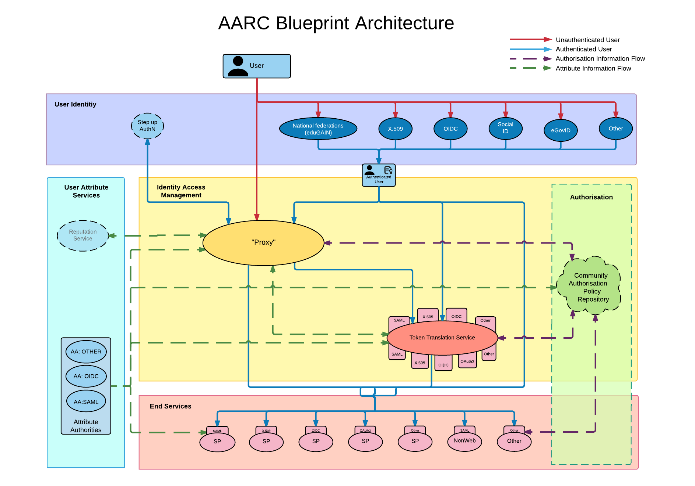
PRACE LDAP
B2ACCESS
PRACE gridFTP
B2STAGE

Slide 8
Status
The work in progress was presented to EUDAT during developers meeting in October
The work was in general accepted and decided to be put in production
Some enhancements were suggested (regarding efficiency in particular)
Deployment agenda was agreed
Implementation (including suggestions) finished in mid November
Documentation in progress
Deployment in a couple of production services planned until the end of December
It is planned be shown in EUDAT final conference in January
Real life tests, corrections, enhancements…

Slide 9
Interfaces
The pilot works with gridFTP B2STAGE
The mechanism is general, so it can be plugged into HTTPS B2STAGE -planned

Slide 10
Group management in EUDAT
Group for each service instance
Group for each community
Normally the groups are managed manually by service/community admins
The pilot is able to add users to some groups (e.g. PRACE) automatically

Slide 11
User consent
Expressing user’s agreement on terms and conditions, processing personal data, etc. to be compliant with Geant Data Protection Code of Conduct and local policies – we assume it is done on PRACE side and expressed in „EUDAT” LDAP attribute.

Slide 12
Lifescience AAI Pilot

Slide 13
Aim
Build an AAI that follows AARC blueprint and that serves multiple lifescience communities
First domain-specific AAI infrastructure
At the moment to serve 11 lifescience infrastructures
Different AAI components to be delivered by EGI, EUDAT and GÉANT.

Slide 14
Plan LS AAI Pilot
31st of Jan 2018 to complite Phase 1 of the pilot:
key pilot components operational
3 first relying services from the research infrastructures integrated to the pilot
Two main milestones:
M1 (22nd Dec 2017) : Test environment ready, connections between SB proxies and NB proxies and PERUN, using dummies SPs and IdPs
M2 (end Jan 2018 ): Pilot available for LS. Connect real IdPs and 3 LS SPs.
Pilot to start on 24th Nov 2017

