Slide 1
AARC2 JRA1 Update
Authentication and Authorisation for Research and Collaboration
Nicolas Liampotis
JRA1, AARC2
GRNET
AARC2 2nd meeting, Amsterdam
21 November 2017

Slide 2
JRA1: Integrated AAI Developments
Storyline
Focus on the integration aspects of the blueprint architecture (BPA)
Provide recommendations and guidelines for implementers, service providers and infrastructure operators on implementing scalable and interoperable AAIs across e-infrastructures and scientific communities
Work in close collaboration with:
  NA2
  NA3
  SA1
  AEGIS
Work on the evolution of the BPA, with a focus on
  identity provider / service provider (IdP/SP) proxies
  scalable authorisation solutions for multi-service provider
  solutions for integrating with R&E federations and cross-sector AAIs

Slide 3




JRA1: Integrated AAI Developments
Cast
JRA1.1 Tools and Services for Interoperable Infrastructures – Diego, EGI Foundation)
JRA1.2 Service Provider Architectures and Authorisation in Multi-SP Environments – Marcus, KIT
JRA1.3 Models for the Evolution of the AAIs for Research Collaboration – Davide, GARR
JRA1.4 Scalable VO platforms – Jens, STFC

Slide 4
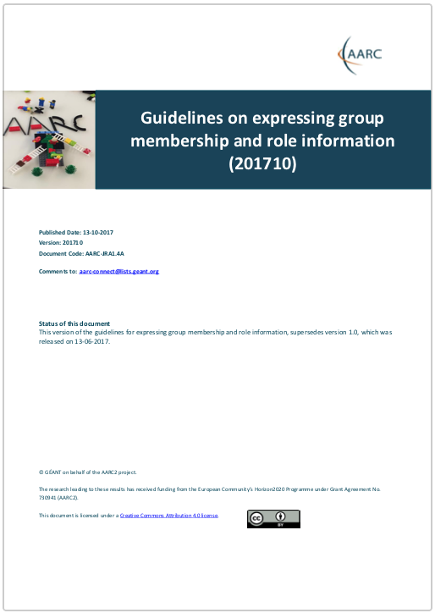
JRA1: Integrated AAI Developments
JRA1.1 status
AARC-JRA1.4A: “Guidelines for expressing group membership and role information”
Standardise the way group membership information is expressed
Indicate the entity that is authoritative for each piece of group membership information
Express VO membership and role information
Support group hierarchies in group membership information
Revision (201710) signed off by AEGIS

Slide 5
JRA1: Integrated AAI Developments
JRA1.1 status
“Guidelines for interoperable exchange of user and community information between AAIs”
AARC2-JRA1.1A: Guidelines for interoperable exchange of user and community information between AAIs: Assurance information – Final draft
AARC2-JRA1.1F: Guidelines for uniquely identifying users across infrastructures (ePUID + subject ID) – Final draft
AARC2-JRA1.1X: Guidelines for exchanging home organisation and affiliation information between infrastructures – NEW

Slide 6
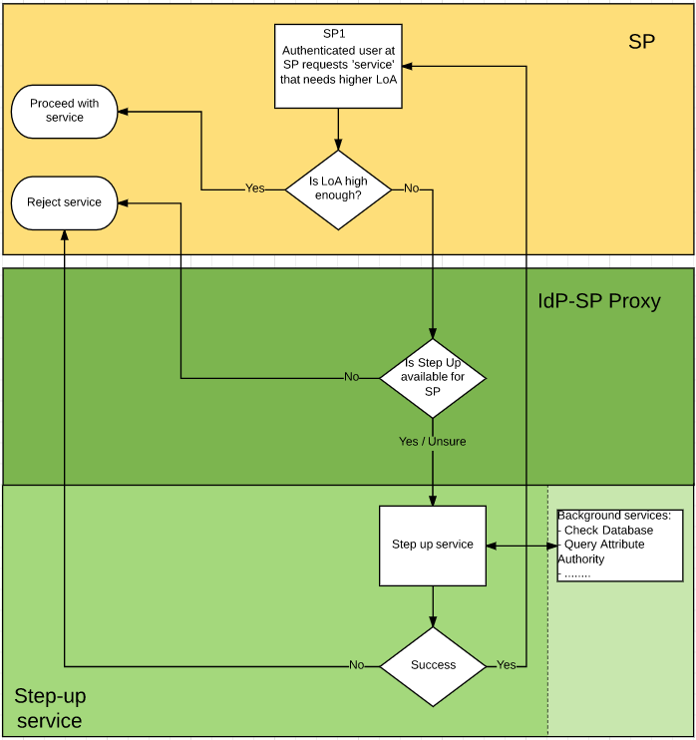
JRA1: Integrated AAI Developments
JRA1.2 status
AARC2-JRA1.2C: “Step-up requirements for SPs”
Main use cases already collected in the doc
Many discussions around the various assurance-related concepts and terms: components, profiles, etc.

Slide 7
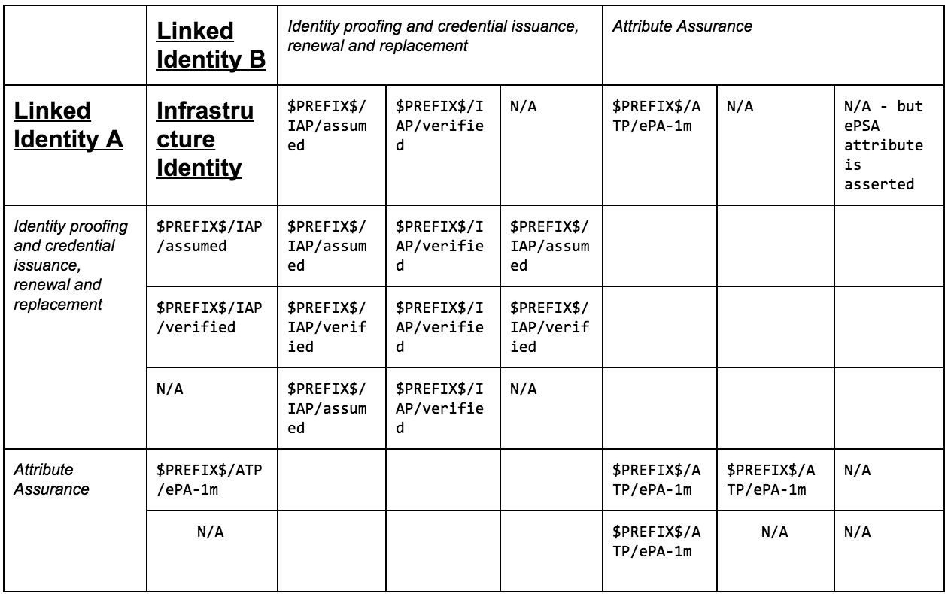
JRA1: Integrated AAI Developments
JRA1.3 status
AARC2-JRA1.3A: “Guidelines for evaluating the combined assurance of linked identities”
First version of the evaluation model already in place
Polishing and extending the identified use cases still pending

Slide 8
JRA1: Integrated AAI Developments
JRA1.4 status
AARC2-JRA1.4A: “Roles, responsibilities and security considerations for VOs”
technically support policies (e.g., involving VO security contacts in incidents relating to their VO)
improved operations (e.g. delegating rights and responsibilities to deputies when the primary person in the role is not available) in a scalable manner
Initial draft
More contributions welcome! ☹

Slide 9
nliam@grnet.gr

