Slide 1
SA1 Update at AARC2 All Hands Meeting, Amsterdam
21-23 November 2017
Arnout Terpstra (SURFnet)
SA1 (Pilots) Activity Lead
AARC2 All Hands Meeting @ Nikhef - Amsterdam - 21-23 November 2017

Slide 2
SA1 Objectives (1)
Pilot (selected) research community use-cases
Mario (GARR), Kostas (GRNET)
Support e-Infrastructures to deploy AARC approach and increase interoperability
Diego (EGI), Peter (EGI)
Pilot advances use-cases, new solutions and approaches:
Kostas (GRNET), Ioannis (GRNET)
Showcase results, deployment scenarios and write documentation:
Andrea (RETI)
Notes:
I myself joined AARC2 in June this year, so I’m relatively new compared to many other participants. Interestingly though, I’ve already had to manage some personnel changes: both the Task Lead for T2 and T3 have left or are leaving within the first 6 months of the project...
Should I be worried about the correlation? ;-)

Slide 3
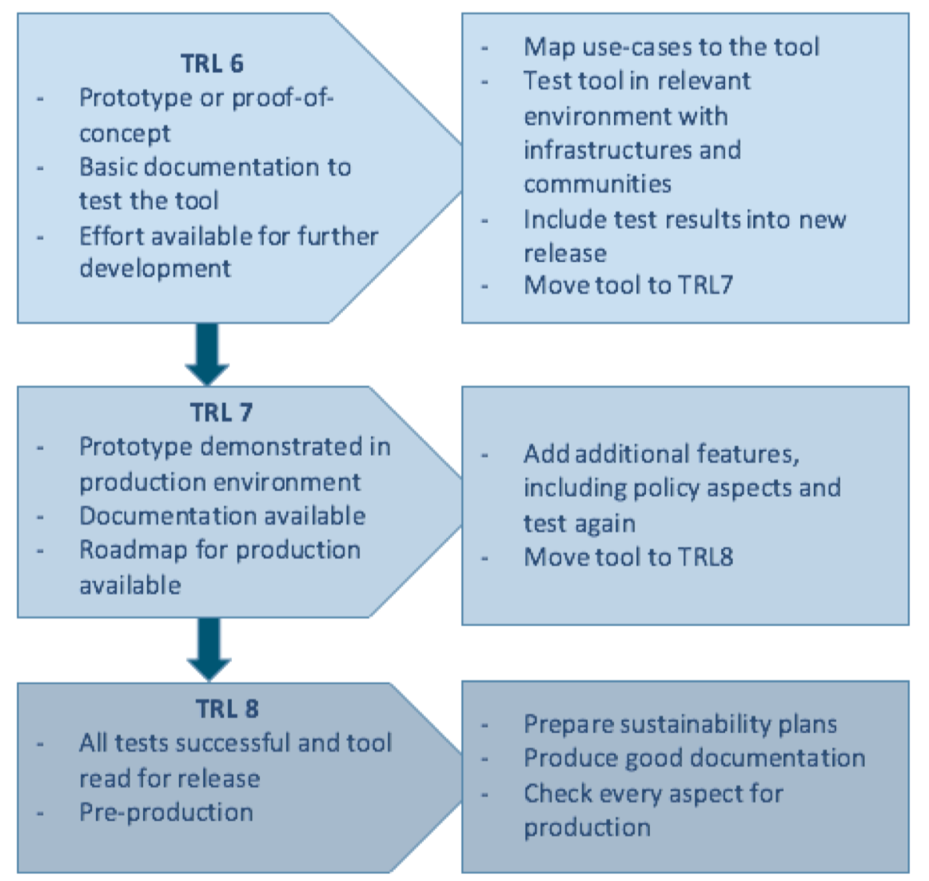
SA1 Objectives (2): Technology Readiness Levels
“All AARC2 results will be at TRL8.”
TRL6 -> TRL7 -> TRL8
Strong focus on (pre-) production AAI
As opposed to trying out new cool stuff?
Communities: build or buy?
e-Infrastructures: prepare?
Notes:
Preparing sustainability plans is out of scope for SA1.
Mostly work for the e-Infrastructures: communities will likely look at them to run their AAI infrastructure. CORBEL is already this far, but we’ll come back to that later.
Use different names: technology proof (trl 6), pilot (trl 8), etc.

Slide 4










Research Communities in SA1.1
LIGO - Physics : Gravitational waves
CTA - Physics: Astronomy
EPOS - Earth Science
LifeWatch - Life Sciences
WLCG - Physics : HEP
EISCAT-3D Physics: Atmospheric physics
HelixNebula - Hybrid Cloud infrastructure
CORBEL - Life Sciences / BioInformatics
Wiki URL: https://wiki.geant.org/display/AARC/AARC2+SA1.T1%3A+Pilots+with+user+communities
Notes:
Goal this F2F: translate requirements (gathered in interviews) to concrete pilot proposals / architectures.
Method: sessions tomorrow, jointly draw architecture. After F2F: finalise pilot intake forms (links will follow in next slides)

Slide 5
1. LIGO: https://wiki.geant.org/display/AARC/LIGO
Simplifying complex user and account provisioning workflow on their distributed clusters (e.g. manual addition of users to the various clusters)
Integrating in a federated provisioning model services computing resources (fed access to non-web applications)
SSH access to VMs
Data Replicator
SAML-to-X.509 Token Translation

Slide 6
2. CTA: https://wiki.geant.org/display/AARC/CTA
IdP/SP proxy (Shibboleth)
COmanage (installed) + Grouper (currently working on)
Adopting SIRTFI
Enhance LoA associated to identities: cappuccino catch-all IdP
Linking local (standalone IdP) identities to federated (eduGAIN) ones
Notes:
TIER approach

Slide 7
3. EPOS: https://wiki.geant.org/display/AARC/EPOS
Guest users (only 40 % users within eduGAIN)
Identity Vetting
Group/Role-based access to instrumental data
Integration with EGI Check-in
Attribute Authority (Unity)
Notes:
EPOS is interested in Distributed attribute management so perhaps a pilot where EPOS AAI based in unity acts as Atribute Authority towards e-infrastrucres AAI
Ideally EPOS users should be able to use EPOS Services and generic e-infrastructure services as a united set regardless of who operates them
Token translation.

Slide 8
4. LifeWatch: https://wiki.geant.org/display/AARC/LifeWatch
IdP/SP proxy
Account linking / Token Translation (ORCID as IdP?)
Citizen scientists
Integration with EGI Check-in?

Slide 9
5. WLCG: https://wiki.geant.org/display/AARC/WLCG
Enable WLCG VO membership registration with non-certificate credentials, both new users and existing (credentials should have sufficient LoA and be integrated with our identity vetting process)
Enable (largely) transparent command line functionality for non-certificate users
Production infrastructure

Slide 10
6. EISCAT_3D: https://wiki.geant.org/display/AARC/EISCAT_3D
Big Data sizes involved: many thousands of users and many petabytes of data
Some form of moderated data access control
Guest users access
Policies?

Slide 11
7. HelixNebula: https://wiki.geant.org/pages/viewpage.action?pageId=87392804
Partnership with commercial providers, help them integrate their services with eduGAIN
Project is (nearly) finished
Valuable lessons learned for eduGAIN
E.g. it was unclear to them how eduGAIN works
Attribute release problems
But: we’re still talking to them to see what AARC can do for them

Slide 12
8. CORBEL: https://wiki.geant.org/display/AARC/CORBEL
Policy and sustainability of their operational model
Splitting of governance of fundamental services between e-Infra and Research-Infra in a well defined way
Governance model to ensure sustainability
On the forefront of BPA: structured AAI model already in place - including BonaFide management, Data Access Entitlement, Operational Workflows
e-Infras submitted combined proposal (EGI, GÉANT, EUDAT)
Notes:
Key point: looking for a sustainable operational model, using existing eInfras. Also, AAI platform alignment (LoA, uniqueID…) with other e-infrastructures
Piloting with task2 - Policy harmonization - Alignment document
Internal harmonization work among different research infras - How to deploy something for an open

Slide 13





e-Infrastructure Providers and interoperability pilots in SA1.2
EGI
EUDAT
PRACE
GÉANT
DARIAH
Wiki URL: https://wiki.geant.org/display/AARC/AARC2+SA1.T2%3A+Support+e-Infrastructures

Slide 14
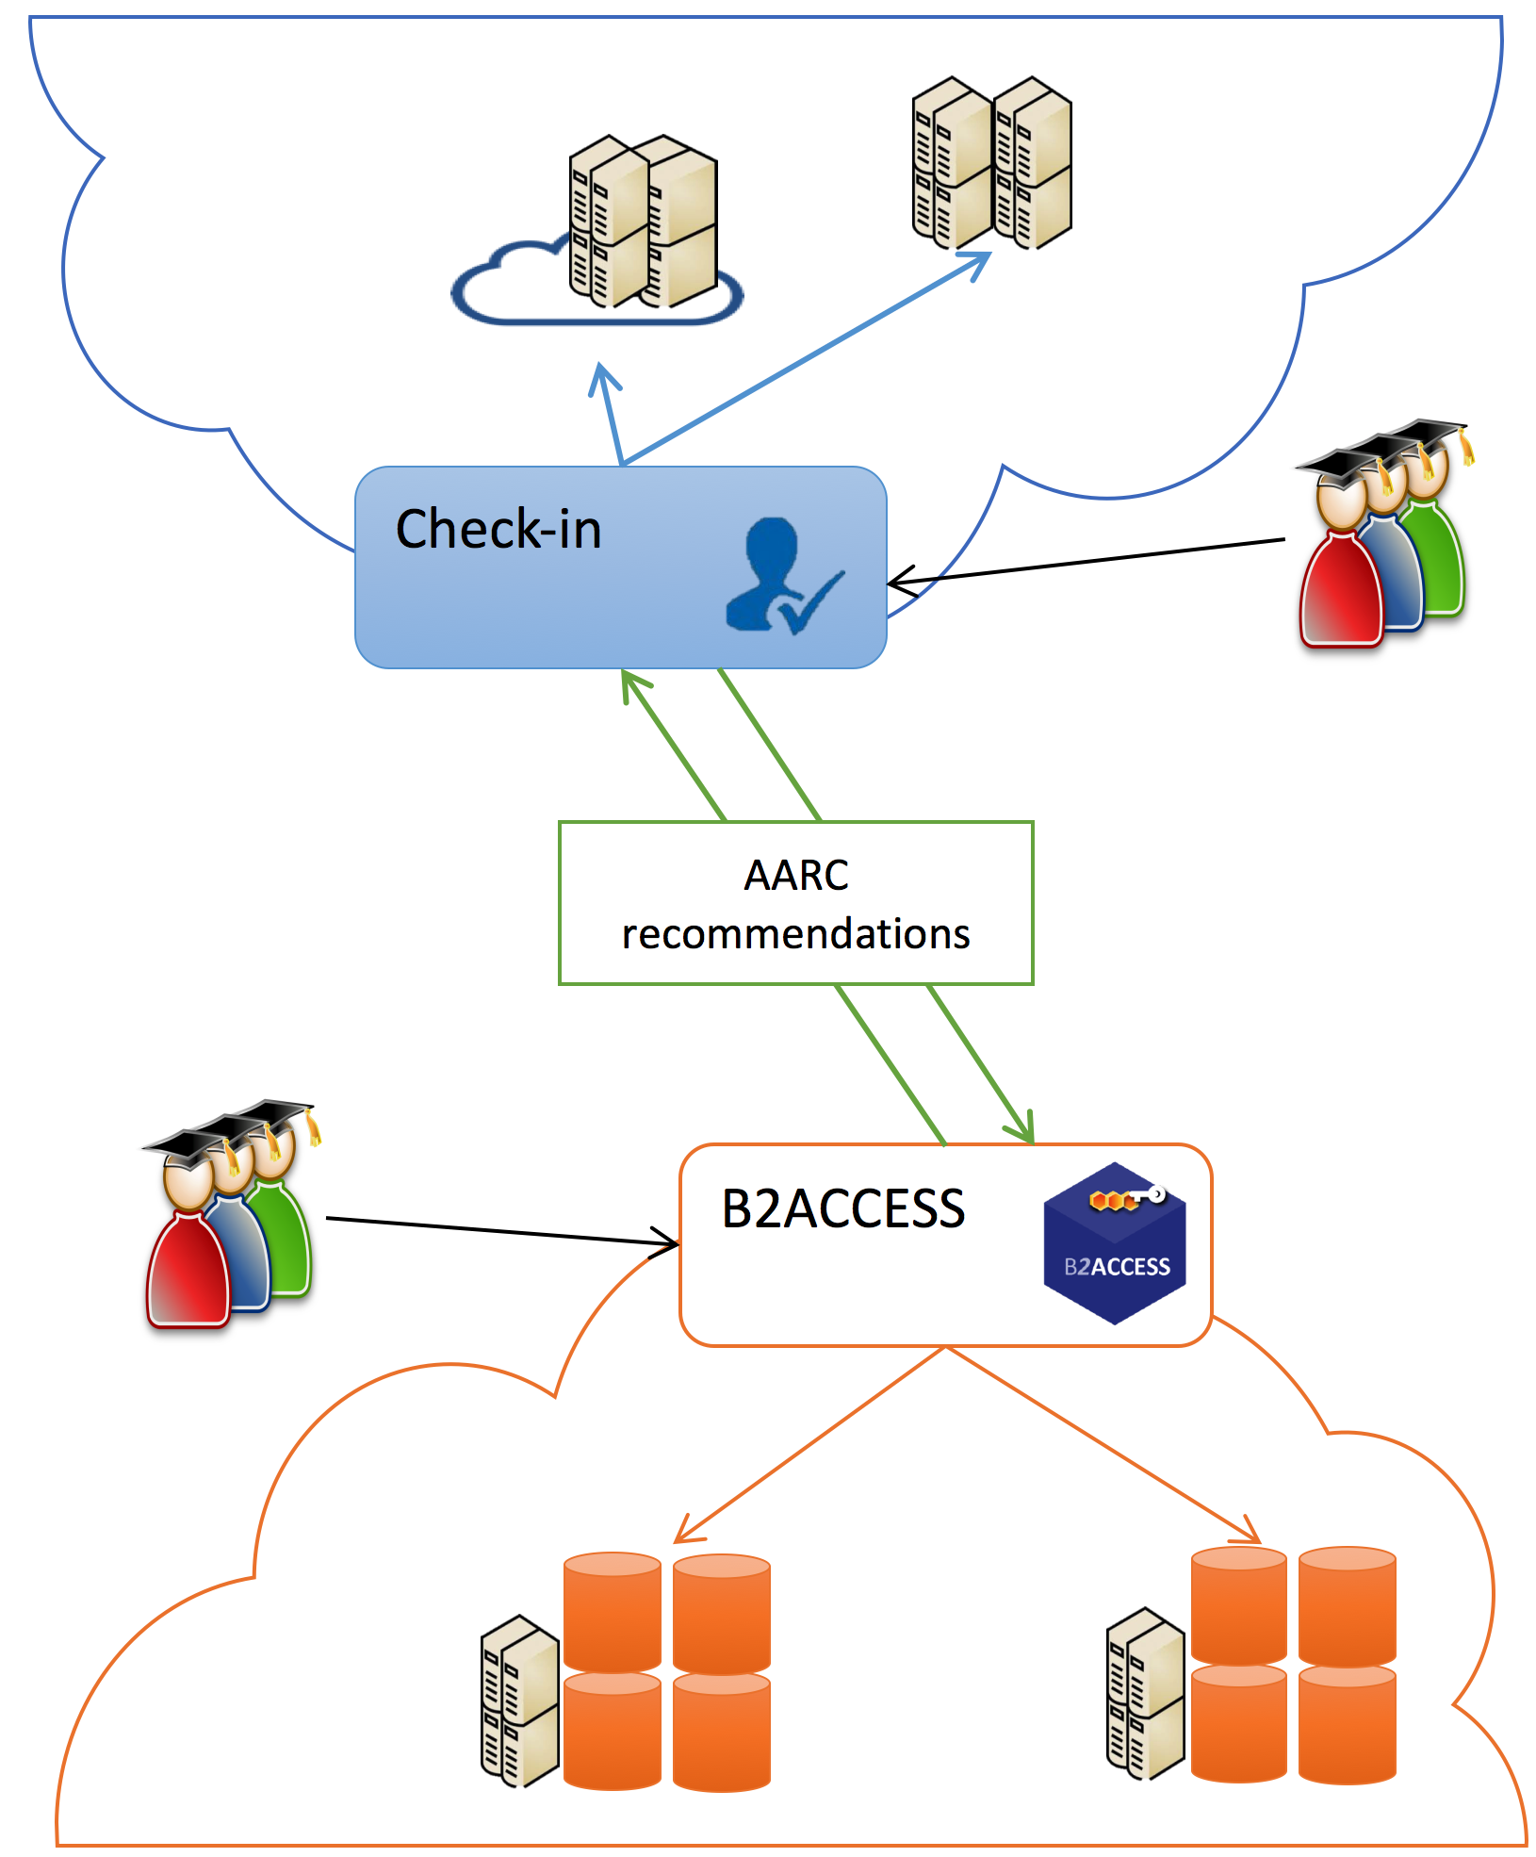
EGI-EUDAT: https://wiki.geant.org/pages/viewpage.action?pageId=90771008
Full interoperability between EGI Check-in and EUDAT B2ACCESS
User communities already integrated in one infrastructure should be able to use services from the other infrastructure in an almost transparent way
Define and implement a workflow to exchange authentication and authorization information between EGI and EUDAT (both ways)
Identity information, LOA information
Group information

Slide 15
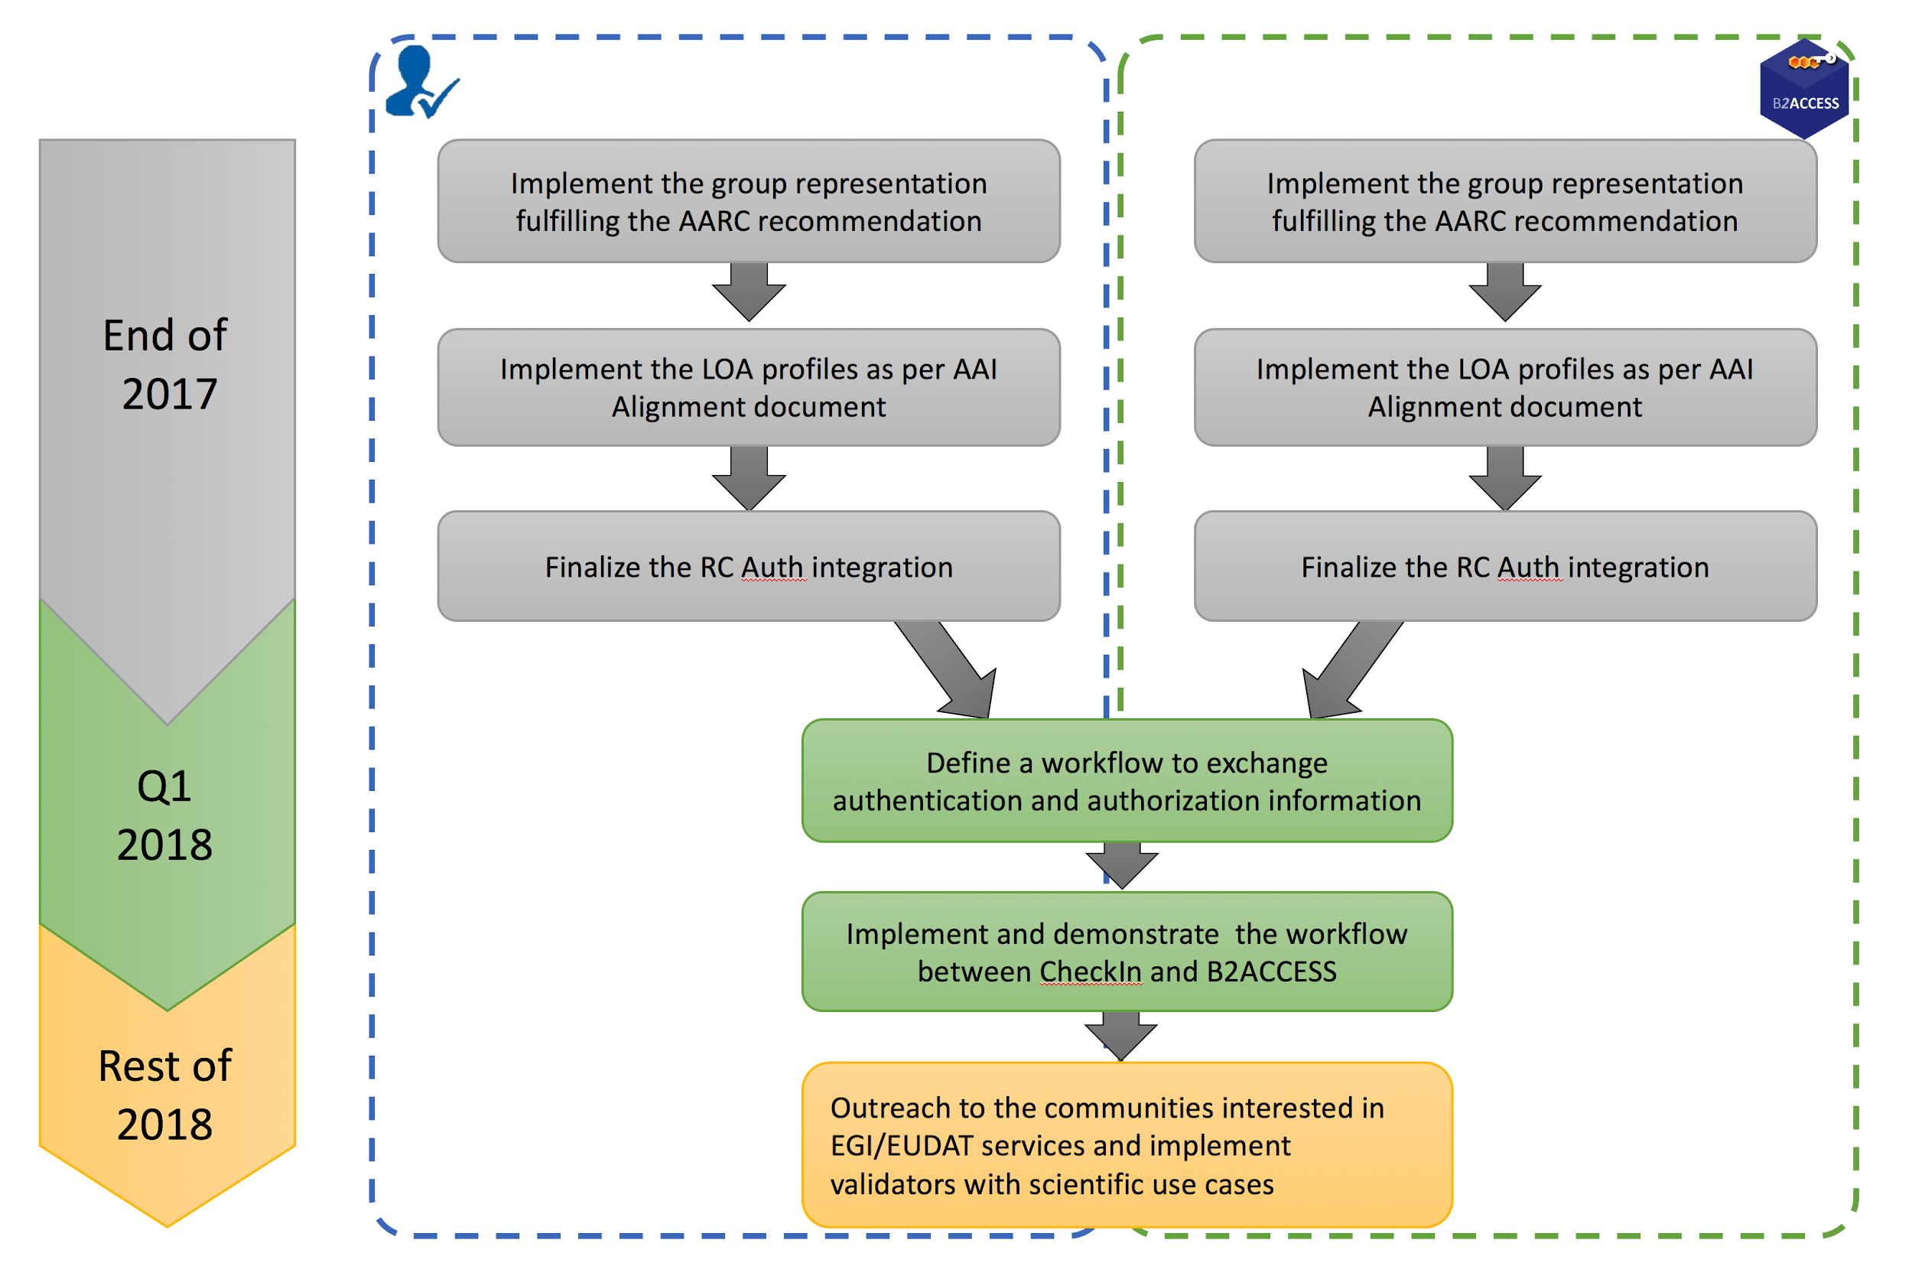
EGI-EUDAT: Lead & Timelines
EGI:
Diego Scardaci
Peter Solagna
EUDAT:
Willem Elbers
GRNET:
Nicolas Liampotis

Slide 16
EGI-GÉANT
Integrate eduTEAMS with EGI CheckIn

Slide 17
EGI-DARIAH
Pilot consists of two parts:
Part 1: Implementation of a SP/IdP-proxy in the DARIAH AAI
Compliant with the AARC Blueprint Architecture
Implementation of AARC recommendations & guidelines
Based on Shibboleth
Part 2: Interoperability pilot between EGI and DARIAH
Timeline
Part 1 until Q1 2018
Interoperability pilot (part 2) afterwards
Concept on: https://goo.gl/R3YFa1
Feel free to comment!
DAASI:
David Hübner
Peter Gietz
EGI:
Diego Scardaci
Peter Solagna
Notes:
Deadlines are still a bit vague, needs some work.
Status:
Initital call in October
Part 1 proxy running as PoC
Implement more features in coming 2-3 months
E.g. ePUID as identifier
AARC group membership recommendations

Slide 18
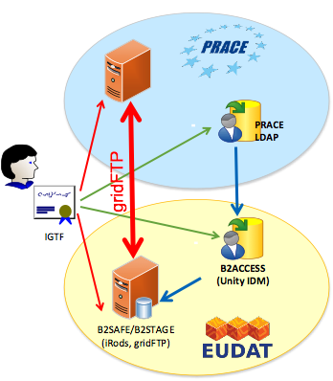
EUDAT-PRACE: Goals
PRACE LDAP – B2ACCESS synchronization
Entity/identity provisioning in B2ACCESS based on LDAP search filter (branch, attributes)
Only users who accepted terms and conditions
Assigning to B2ACCESS groups based on LDAP filter
Still the admin may manually assign an entity to additional group, define attribute or disable it
Users processed in bulk periodically
B2ACCESS – B2STAGE/B2SAFE synchronization
B2SAFE account provisioning and DN mapping (1-1) on demand
Assigning to B2SAFE groups based on B2ACCESS group membership
Support for certificates:
Used as B2ACCESS credentials (e.g. IGTF)
Generated by B2ACCESS
Single user processed online, just before the standard authorization
Notes:
Very high level goals:
Provision PRACE users in EUDAT B2ACCESS
Provision B2ACCESS users in B2SAFE/B2STAGE

Slide 19
EUDAT-PRACE: Status & People
The work in progress was presented to EUDAT during developers meeting in October
The work was in general accepted and decided to be put in production
Some enhancements were suggested (regarding efficiency in particular)
Deployment agenda was agreed
Implementation (including suggestions) finished in mid November
Documentation in progress
Deployment in a couple of production services planned until the end of December
Real life tests, corrections, enhancements…
Expressing user’s agreement on terms and conditions, processing personal data, etc. to be compliant with GÉANT Data Protection Code of Conduct and local policies –to be discussed and clarified.
EUDAT:
Willem Elbers
EUDAT/PRACE:
Claudio Cacciari
Giuseppe Fiameni
PRACE:
Michal Jankowski
Ralph Niederberger

Slide 20
GÉANT-EUDAT
Integrate eduTEAMS with EUDAT B2ACCESS

Slide 21
EGI-GÉANT-EUDAT
CORBEL / LifeSciences infrastructure proposal
Combined AAI between EGI, GÉANT and EUDAT
To be further discussed on Thursday

Slide 22

T1
Pilots schedule
today
August 1,
2017
November 1,
2017
February 1,
2018
May 1,
2018
August 1,
2018
November 1,
2018
February 1,
2018
May 1,
2018
May 1,
2017

Slide 23
T2
Pilots schedule
today
August 1,
2017
November 1,
2017
February 1,
2018
May 1,
2018
August 1,
2018
November 1,
2018
February 1,
2018
May 1,
2018

Slide 24
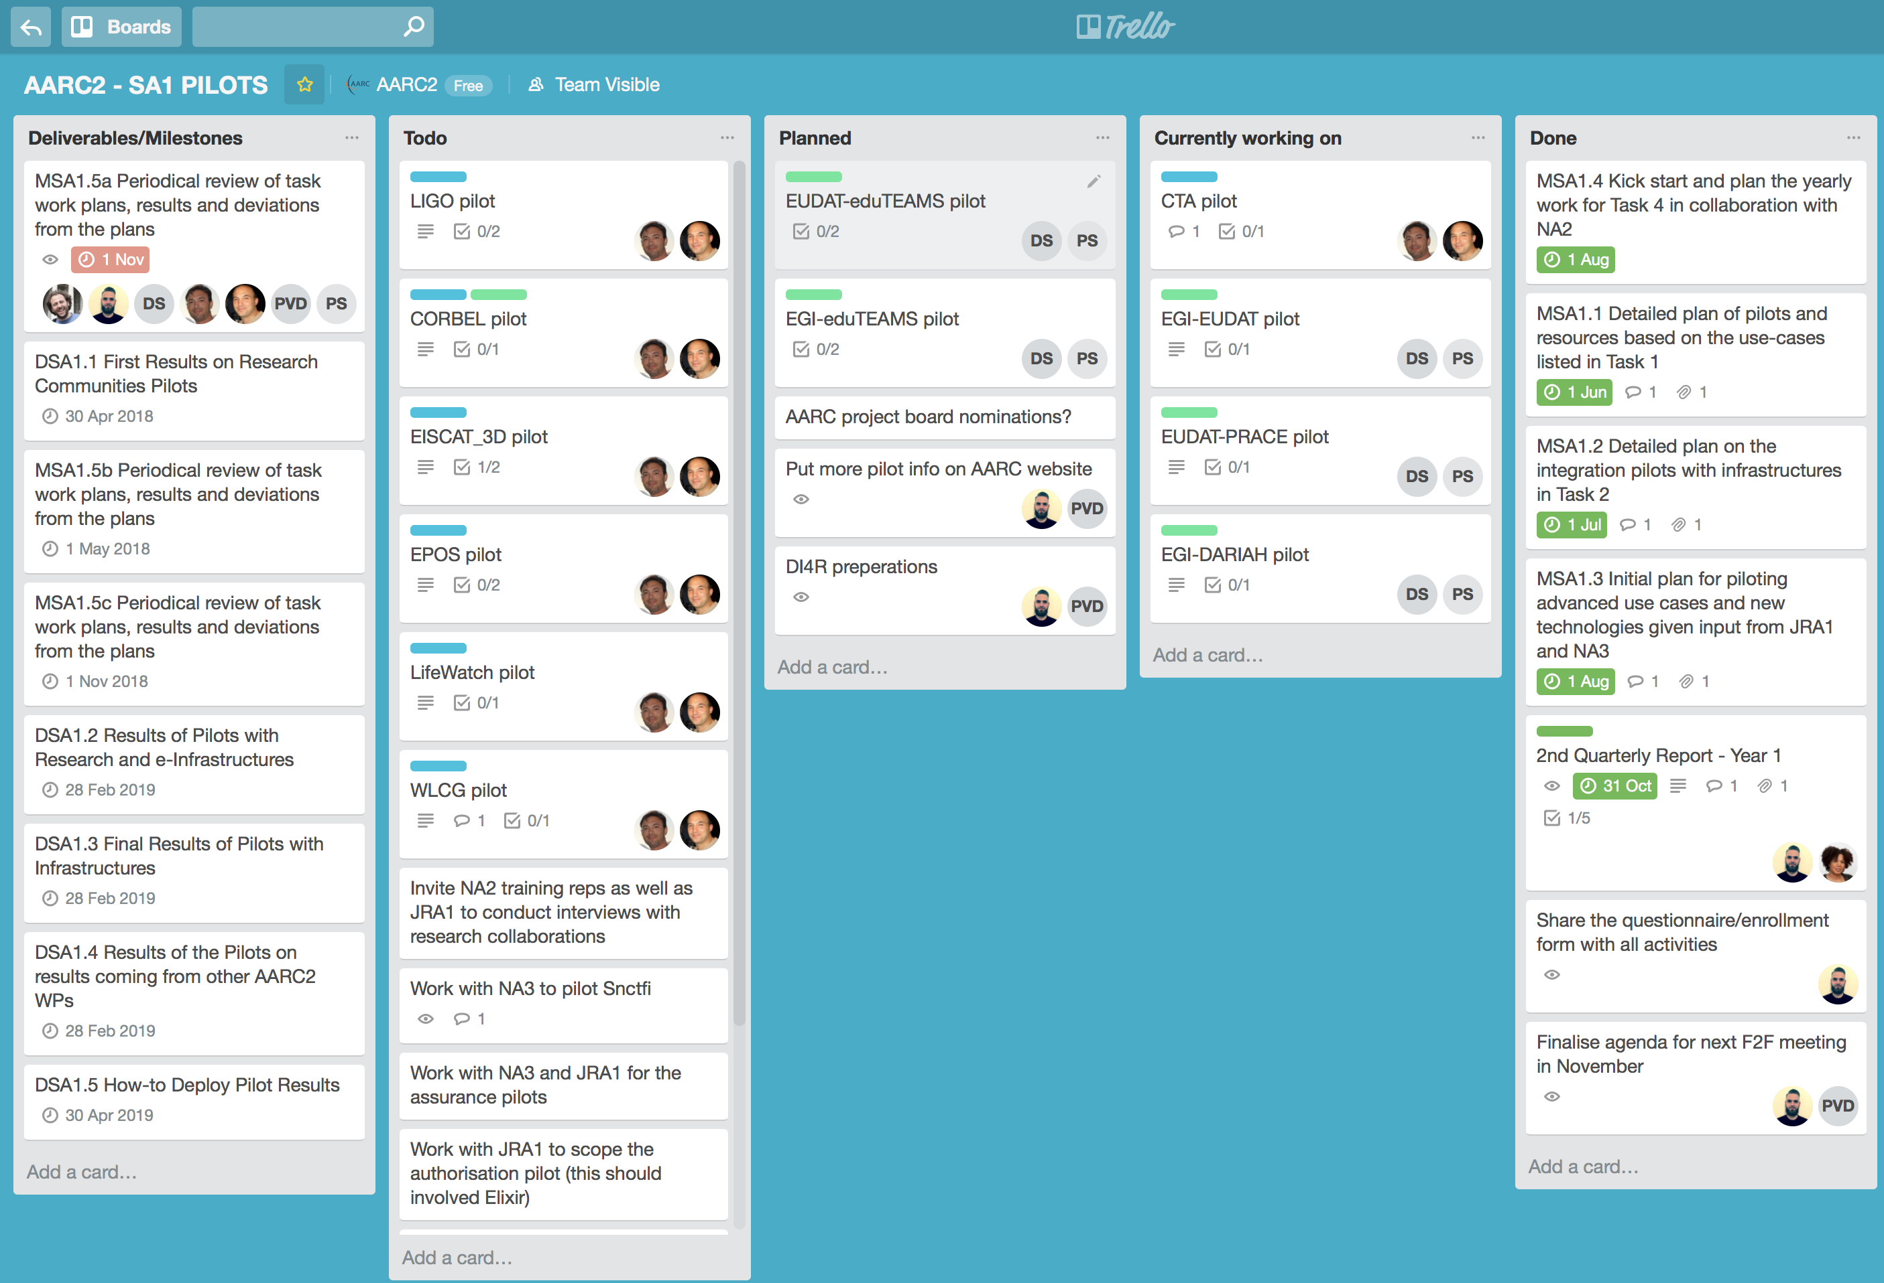
Progress

Slide 25
What’s next?
Now: F2F meeting, translate requirements to concrete proposals/architectures
Interactive session tomorrow morning, details will follow
Soon: another plug-fest (Q1/Q2 next year)
When?
Soon: first deliverable (due 30 April 2018)
DSA1.1 First Results on Research Communities Pilots
Prepare!

Slide 26
arnout.terpstra@surfnet.nl

