Slide 1
Thursday pilot session: 7-minutes
6 Presentations
  Show us what work will take place within SA1 (action points, timelines)
  Show (high-level) architecture/components
7 minutes each
No deviations!
Order:
  CTA (Alessandro)
  WLCG (Hannah)
  LIGO (Paul H.)
  EPOS (Mariusz)
  EISCAT_3D (Ingemar)
  DARIAH-EGI (David H.)

Slide 2
1: CTA (1/3)

Slide 3
1: CTA (2/3)

Slide 4
1: CTA (3/3)
Actions (6 months):
IMPORT in COmanage from CTA LDAP -> Collaboration named “CTA IdP”
User Auto Enrollment with Administratin Approval for EduGAIN users
User logs in, a “petition” starts, the Administrator approves it
Administration Enrollment Flow in Comanage for account linking
Proxy (test version) -> Shibboleth

Slide 5
2: WLCG (1/2)
The VOMS backend will need to be maintained for some time, however VOMS-Admin can/should be replaced
VOMS provisioning is the piece of the puzzle that is not complete
  User registration flow with non-x509 credentials (integration with CERN HR DB must be maintained)
  Adding DNs from RCAuth to VOMS for new and existing users
CERN’s SSO will potentially be a single IdP for whatever we use for group management (first attempt probably IAM)
Likely that RCAuth Master Portal will be set up at CERN *but* we can use the EGI Checkin one for the pilot
Using IAM + RCAuth will let us use the ssh-key command line flow
We have a second “pilot” activity to define and test and interoperable schema for JWT tokens between EGI and OSG

Slide 6
2: WLCG (2/2)
Actions:
Mischa to talk with Andrea and see whether IAM can do what we want (no marketing pitch allowed!)
Hannah to set up a call for the JWT tokens profile
Prepare updates for the call on 14th of December at 16:00 CET

Slide 7
3: LIGO
IdP
IdP
IdP
IdP
Add IdP/SP proxy to allow federated access to LSC resources.
Liaise with US based IAM Architects.
Design IdP/SP proxy architecture.
Investigate implications for SPs (e.g. may assume only LIGO IdP, or incorrect access rules).
Identify replacement for CLI certificate proxy download (Token translation).
Possibly replace my.ligo.org with COManage instance.
my.ligo.org
(COManage)
Proxy
SP
SP
SP
SP

Slide 8
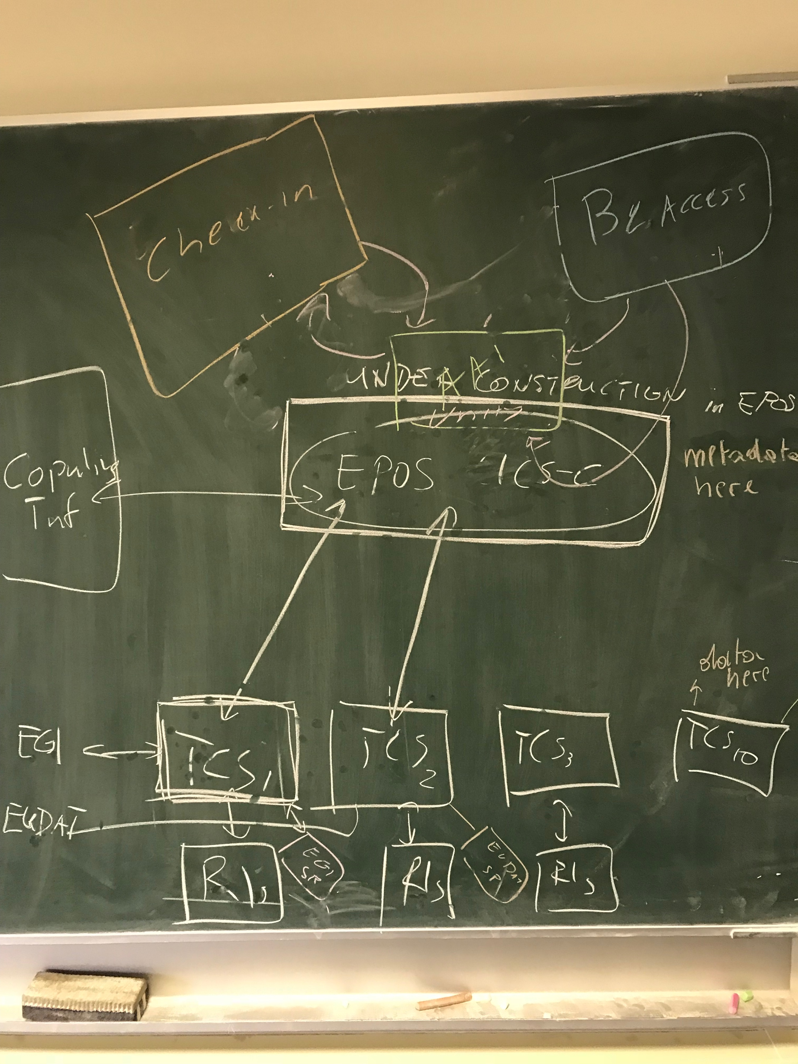
4: EPOS (1/5)

Slide 9
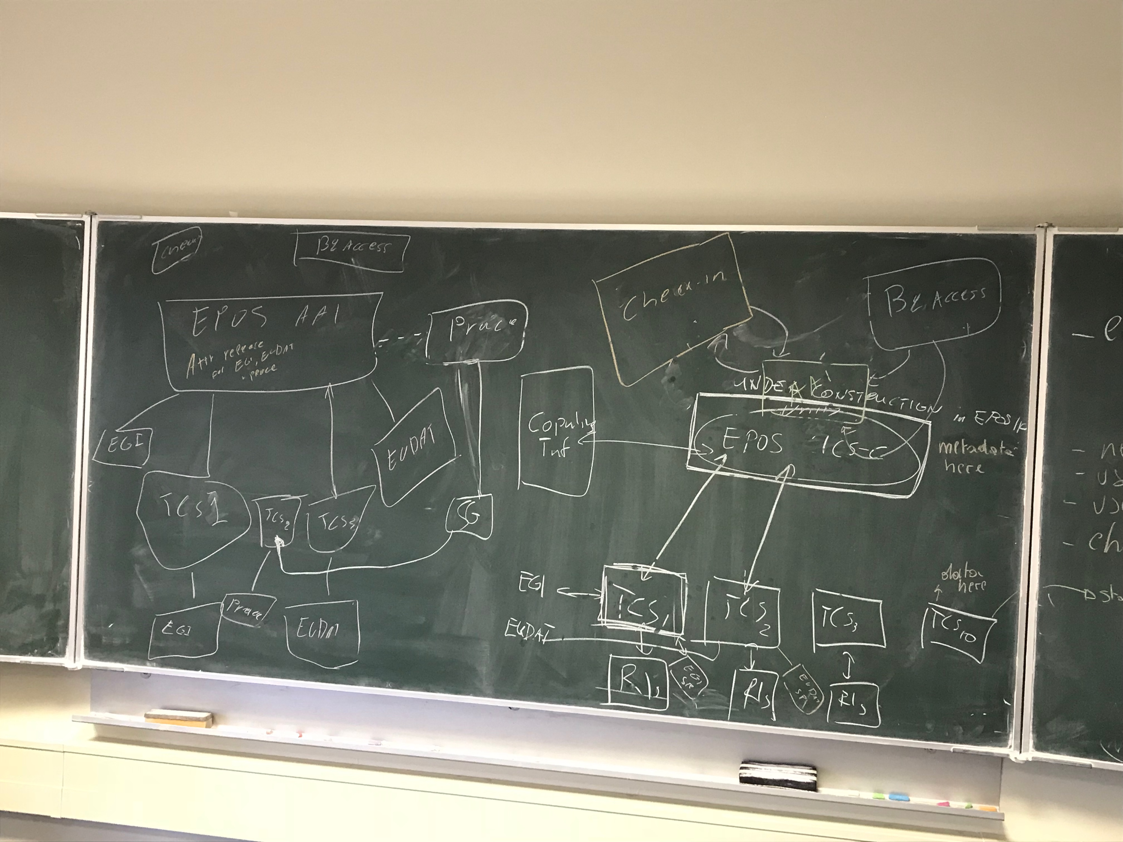
4: EPOS (2/5)

Slide 10
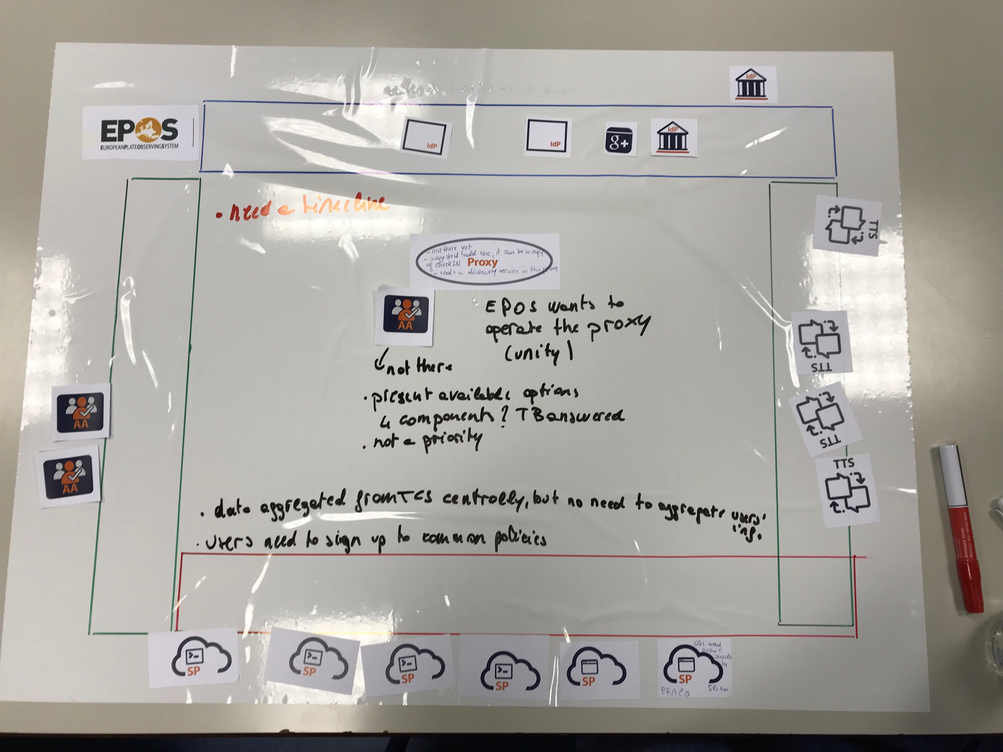
4: EPOS (3/5)

Slide 11
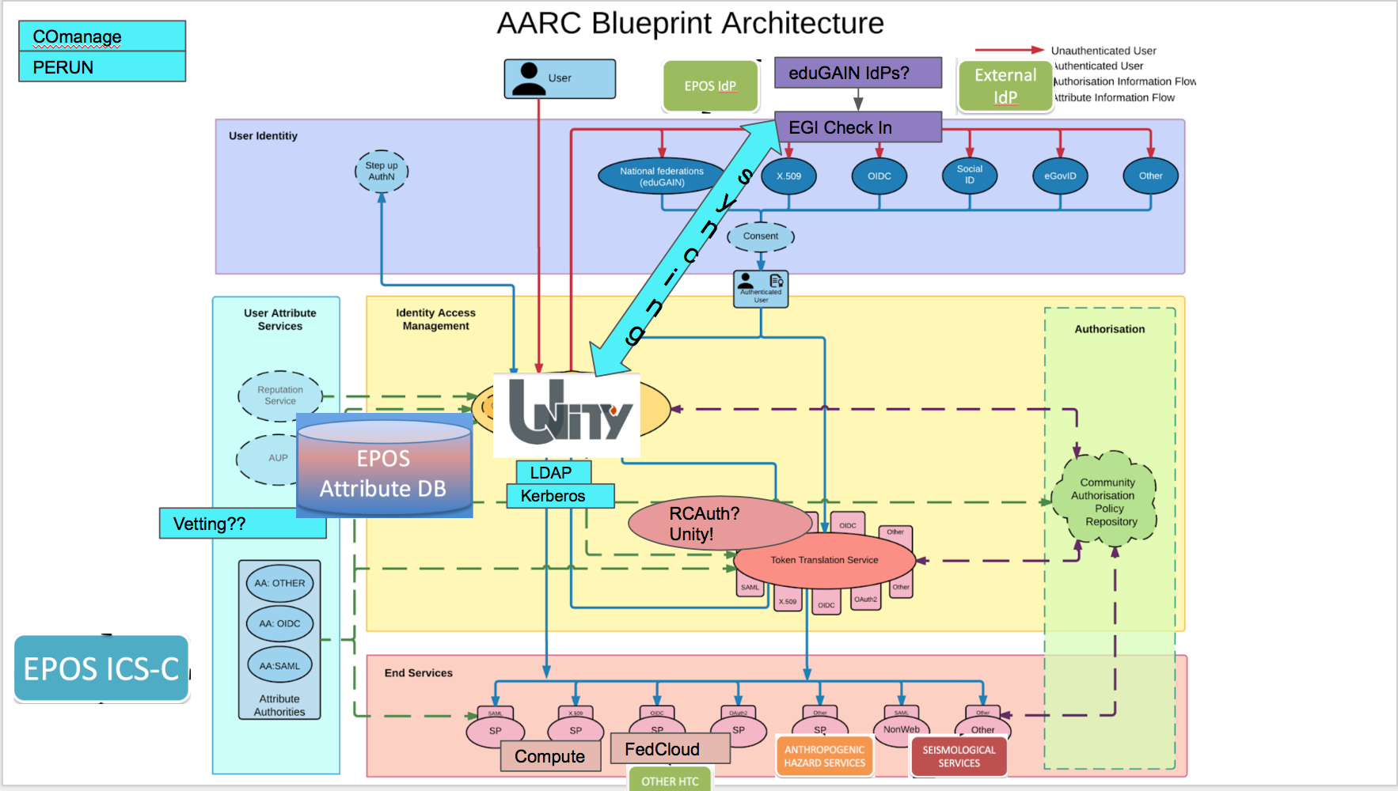
4: EPOS (4/5)

Slide 12
4: EPOS (5/5)
Actions for next 6 months:
Obstacle – EPOS ICS-C „under construction”
Set up local EPOS IdP service
Bind it with the pilot
Start integrating TCSs (the two with binds to EGI and EUDAT) with the pilot

Slide 13
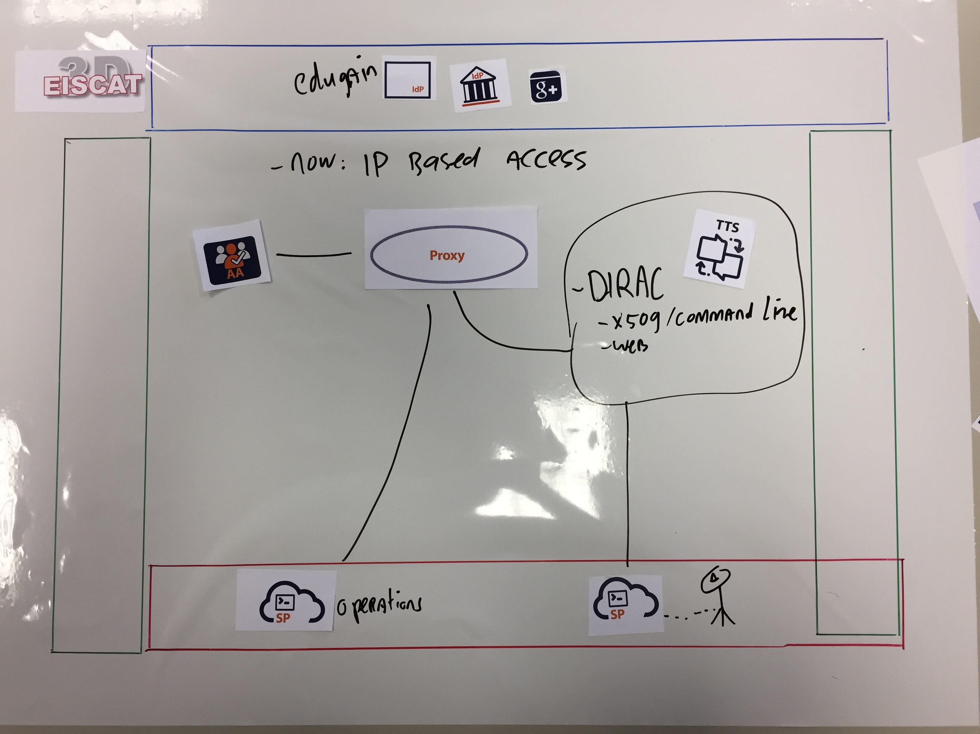
5: EISCAT

Slide 14
5: EISCAT_3D (2/3)
Users
Data/Processing
  Associate (RC, country)
  Affiliate (institute)
  3P (individual)
  Staff
  Other (non commercial/military)
Operation
  Request (member..)
  Expert (selected users)
  Staff
  Machine (predefined)
Data service
  Dirac (x509..)
  Staging/Processing
    Generic EISCAT
    Own funds
  Operation service
    ?
Actions points
Talk to John White: propose basic architecture

Slide 15
5: EISCAT_3D (3/3)
IdP
  Edugain (also JP,KR)
    US?
  EGI
  EUDAT
  Outsiders
    Ukraine, China?
  US?
    NSF?
  Non edu?
    Social login, orcid?
    Up to each RC?
EISCAT
  Mainland, KST
    UHF, VHF
      Will be replaced by EISCAT_3D
  HF
    Heating, dynasonde
  Svalbard, ESR
ToDo
  Proxy
    Provide user category
    Minimise manual approvals

