Slide 1
AARC what’s next?
Authentication and Authorisation for Research and Collaboration
Licia Florio
AARC Project Coordinator
Presenter affiliation
AARC All Hands Meeting
21-23 Nov 2017, Amsterdam

Slide 2
Relevant Trust and Identity activities
REFEDS
AARC
Other IDs
Fed Ops
Bridging FIM & eScience
eGov, GAFA
FIM4R/IGTF
Trust Infras/ eduGAIN
eScience
EOSC

Slide 3
After 2019….
EOSC-H starts
EOSC pilot continues
???
Dec 2018
2019
2020
Apr AARC project ends

Slide 4
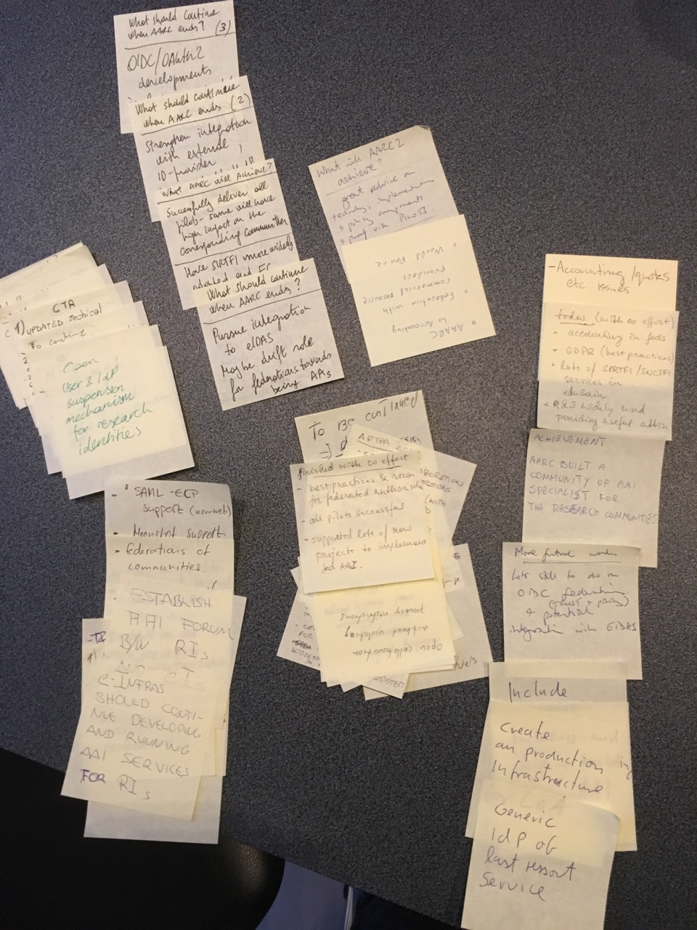
Thoughts
Questions
Answers
What do you expect AARC will achieve?
What should continue when AARC ends?

Slide 5
Licia.Florio@geant.org

