Slide 1

NA2 Overview
(AARC2.AHM)²
Andrea Biancini
NA2 WP leader
Reti SpA
AARC2 Second Meeting, Amsterdam
November, 21st 2017

Slide 2
NA2.0 Work package leadership
This Task is to lead the Activity as a whole:
to provide the necessary support for outreach and effective training delivery,
to ensure cooperation with the other work packages, as well as to facilitate communication between the communities and those operating the infrastructures.
NA2 strategy document: https://wiki.geant.org/download/attachments/86278160/AARC%20Strategy%20for%20NA2.docx?api=v2

Slide 3
NA2.1 Outreach and Communication
Objective:
to reach out to AARC communities to promote use of federated access and results from AARC.
develop all the necessary material to promote the work done in the other work packages.
Twofold approach:
Outreach – Continue the outreach to optimise the uptake of federation identity,
reach out to communities not yet approached
liaise with other relevant projects/communities
Communication – Facilitate interaction and communication among the communities and between the communities and the infrastructures by means of two delivery platforms:
The Community Engagement Forum (CEF) – An open forum for engaging with user communities, rooted in FIM4R.
AARC to get feedback on AARC results and get new research communities requirements to validate AARC work
To provide training if needed.
The AARC Engagement Group for Infrastructures (AEGIS) – Bilateral channel with r/e-infrastructures to endorse AARC recommendations and to ensure AARC results are deployed. NA2 provides support for communication.

Slide 4
NA2.2 Training
The objective of this Task is to reach out to AARC targeted communities and promote the use of federated access via training. The Task will offer:
Basic training (Fed 101)– addresses AARC research communities that have not deployed federated access to present FIM key aspects and benefits.
Advanced training – The Task addresses AARC research communities that have already an AAI and are offering federated access but want to adopt AARC blueprint architecture and related policies
Training on AARC/AARC2 results – Training specific results and/or pilots.

Slide 5
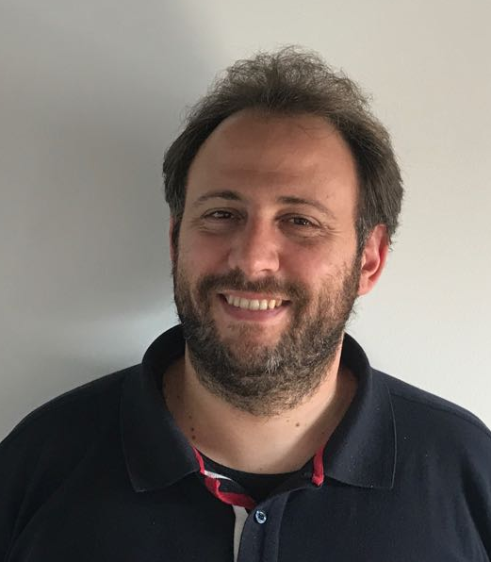


NA2 Training and Outreach The work package structure
Task | People
NA2.0 Work package leadership | Andrea Biancini (RETI)
NA2.1 Outreach and Communication | Laura Durnford (GÉANT) Elis Bertazzon (GARR) Sara Coelho (EGI.eu) Irina Mikhailava (GÉANT) Martine Oudenhoven (LIBER) Jiri Pavlik (MZH)
NA2.2 Training | Lalla Mantovani (GARR) Andrea Biancini (RETI) David Hübner (DAASI) Marco Malavolti (GARR) Irina Mikhailava (GÉANT) Hannah Short (CERN) Uros Stevanovic (KIT) Federica Tanlongo (GARR) Nadia Sluer (GÉANT)

Slide 6


Communication and Outreach Updates – 1/3
AEGIS
Created icon for AEGIS & CEF
News AEGIS launch (& CEF)
Helped prepare 1st AEGIS briefing
Helped prepare & disseminate news AEGIS endorsed guidelines
Helped prepare Di4R AEGIS interview
Disseminated invitation to AEGIS workshop at EOSC event 29 Nov
CEF
Creation CEF icon
News CEF launch (& AEGIS)
News FIM4R reloaded
Initial communication plan with FIM4R

Slide 7


Communication and Outreach Updates – 2/3
Sirtfi
Sirtfi moodle content corrections
Sirtfi moodle news
Website
Web map & review of attached materials
What needs updating / replacing / filling in?
Ongoing small website improvements
EU materials
Prep begun leaflet on AARC & eduGAIN
News
EISCAT_3D construction gets go ahead
Roadmapping T&I activities

Slide 8

Communication and Outreach Updates – 3/3
Partner outputs
EGI newsletter article upcoming on AEGIS
GARR article incl. LIGO & CTA user stories

Slide 9

Communication and Outreach Ongoing / in planning
Current activities:
Review & update of materials online
CEF / FIM4R communications
AEGIS briefings & news
EU materials
What does AARC do for infrastructures - web content & publication (thanks to EGI)
AARC results (i.e. Snctfi, architecture etc.)
Next: we need your inputs!
Partner outputs
News
User stories / testimonials etc.

Slide 10
andrea.biancini@reti.it

