Slide 1
AARC Overview
Authentication and Authorisation for Research and Collaboration
Licia Florio
AARC Project Coordinator
Presenter affiliation
AARC All Hands Meeting
21-23 Nov 2017, Amsterdam

Slide 2
What has happened so
AARC objectives and target group
Administrative info
Progresses from last meeting
Engagement with global relevant activities

Slide 3
AARC Vision
Avoid a future in which new research collaborations develop independent AAIs
Deliver production-ready architectural building blocks and best practices to enable r/e-infrastructures to build interoperable AAI

Slide 4

Who are our main ‘customers’?
Research and e-infrastructures
AARC should act as the interface between the eScience and the federations/eduGAIN
Libraries?
Not really in scope for AARC2
We should continue and promote the work done in the last 2 years.
Everything that involves campus and institutions is not in scope
Unless it is about providing recommendations

Slide 5
Administrative info

Slide 6

Project Overview - Consortium Agreement
AARC2 consortium agreement signed in Sept
Two aspects need clarifying:
IPR
Financial bankruptcy of a partner
IPR (background information of the agreement)
The IPR (“Whatever changes made to the software within the project the IPR remains with Organisation A”) is not in line with general IP law, and in particular not in line with the fundamental IP principle establishing that “Results are owned by the Party that generates them” (Section 8): if a Party makes a fundamental change to the Organisation A software (derivative work), that change is a Result that no longer belongs to Organisation A but to the Party having generated that Result.
This fundamental IP principle is also established in the Grant Agreement that takes precedence over the Consortium Agreement.

Slide 7
Project Overview – Consortium Agreement
Financial bankruptcy of a partner
The EC Guaranteed Fund may not always be used to recover budget given to a partner that defaults
This results in the consortium having to absorb the costs.
Mitigation of this risk
AARC2 CA includes the rights for the Coordinator to take the necessary steps to assess partners financial risks.
Prior to distributing the pre-financing, GÉANT has carried out a financial evaluation of the partners.
The mitigation in place was to allocate only part of the pre-financing to partners that did not have the highest ranking
Such a process is in place and GÉANT will continue to carry out periodical checks.

Slide 8

AARC Project Board
AARC Board appointed:
Davide Vaghetti (GARR), Tiziana Ferrari (EGI), Klaas Wierenga (GÉANT), Petr Holub (BBMRI-ERIC), Tommi Nyrönen (CSC/Elixir) and Ingemar Häggström (EISCAT)
Meets 3 times per year.
Duties of the board:
execution of minor budget adjustments;
supervision of the performance of all the Consortium members in the Project, and the introduction of remedial actions to be taken when the Project is not progressing to plan;
advice in case of disputes;
advice the coordinator on changes to the budget and/or any other change to what described in the DoW.

Slide 9
Progresses

Slide 10
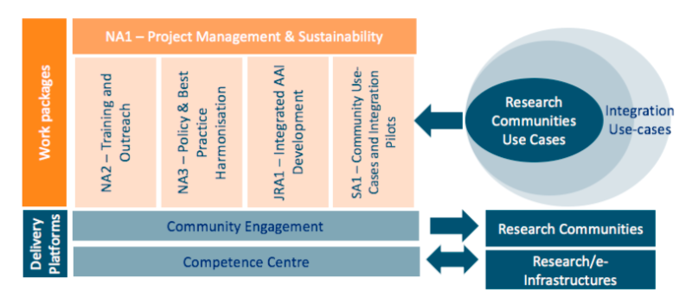
Make AARC Results available outside AARC

Slide 11


AEGIS and CEF
r/ e-infras
NA3
SA1
NA1
NA2
JRA1
FIM4R
AEGIS
REFEDS
WISE
IGTF
Results we want others to use/get
CEF
Ensure sustainability of AARC results

Slide 12
Progresses since kick-off meeting
Started executing engagement plan
Discussing a collaboration agreement with EOSCpilot
Good conversation with other infrastructures via AEGIS
Agreed to look in more detail to the LF AAI requirements and pilot
Significant progresses on this

Slide 13
Slower progresses than planned
Pilots – things not yet completely running
KPI: deliver 3 pilots in the first 10 months of AARC
LS AAI needs to start asap
Training – good progresses in terms of requirements
But we need to agree on what to start to implement
Infoshare – we have not had any!

Slide 14
Resources
Human effort is still a problem
Some people leave
Some people are not able to spend as much as planned
Not easy to find resources with the skills we need
Figures not clear, not everybody has reported time
We need to avoid underspending

Slide 15
name@yourorg.org

